Slide 1

Signal Integrity Education
June 2015
Team 12
Owners: Travis Berger, Luis Santiago

Slide 2
Objective
The objective of this Capstone Project was to create two experiment boards that help students build an intuition for signal integrity issues.

Slide 3
Experiments
Mixed Signal Ground Techniques
ISI/Crosstalk

Slide 4
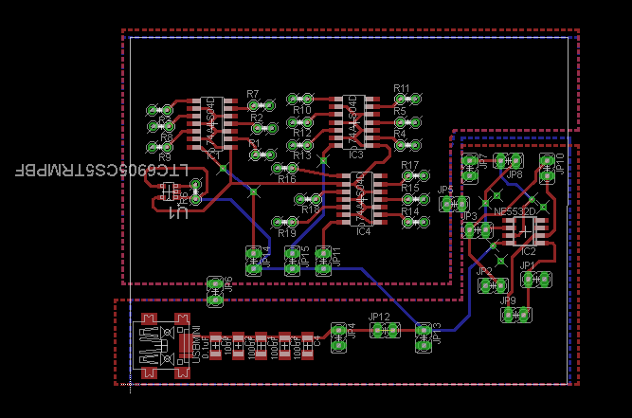
Mixed Signal Ground Techniques
Isolation
Digital Circuity With
Semi-Isolated Ground Plane
Return Path B
Return Path A
Analog Circuity
Source

Slide 5
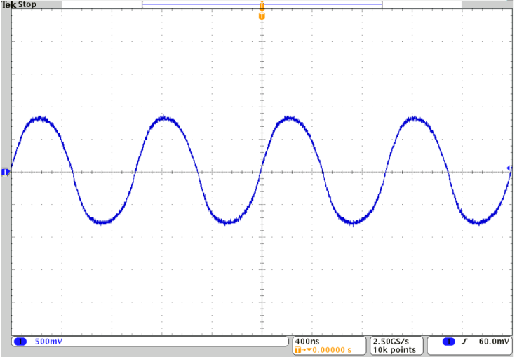
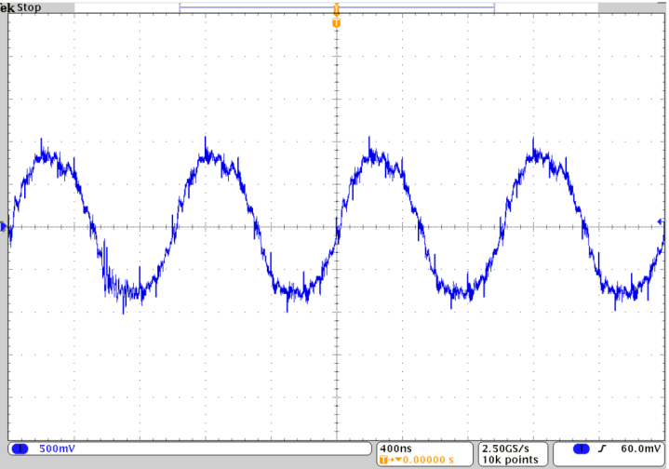
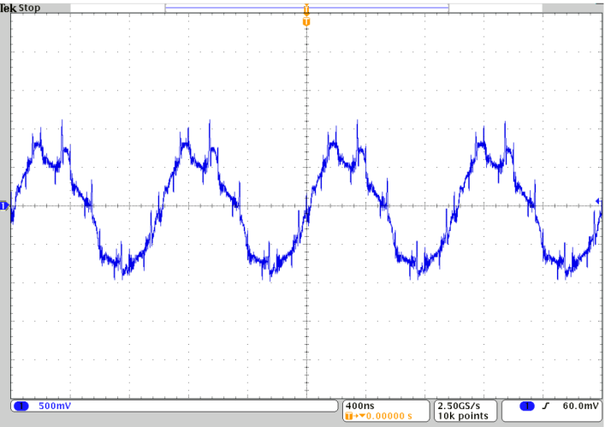
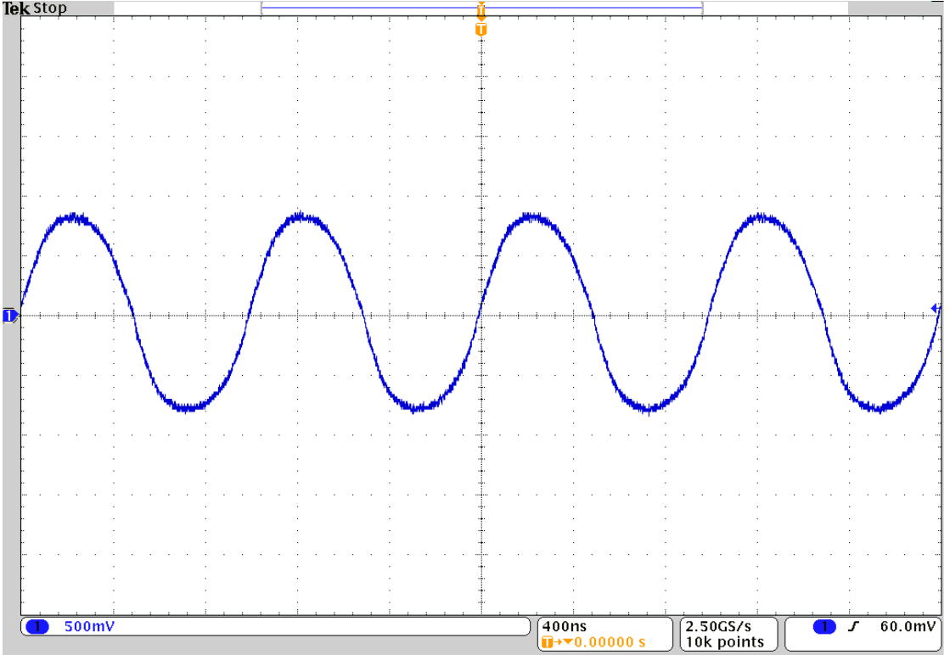
MSGT Measurement results
Analog signal without digital
Interference

Slide 6
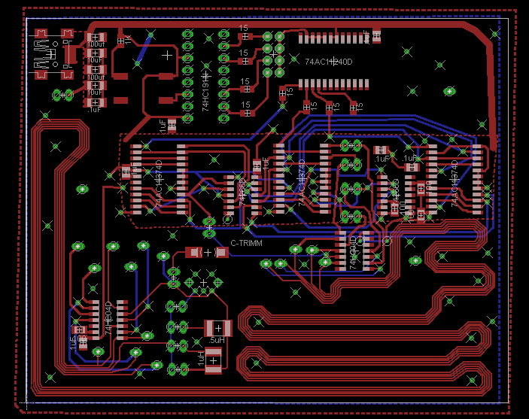
ISI/Crosstalk Experiment

Slide 7
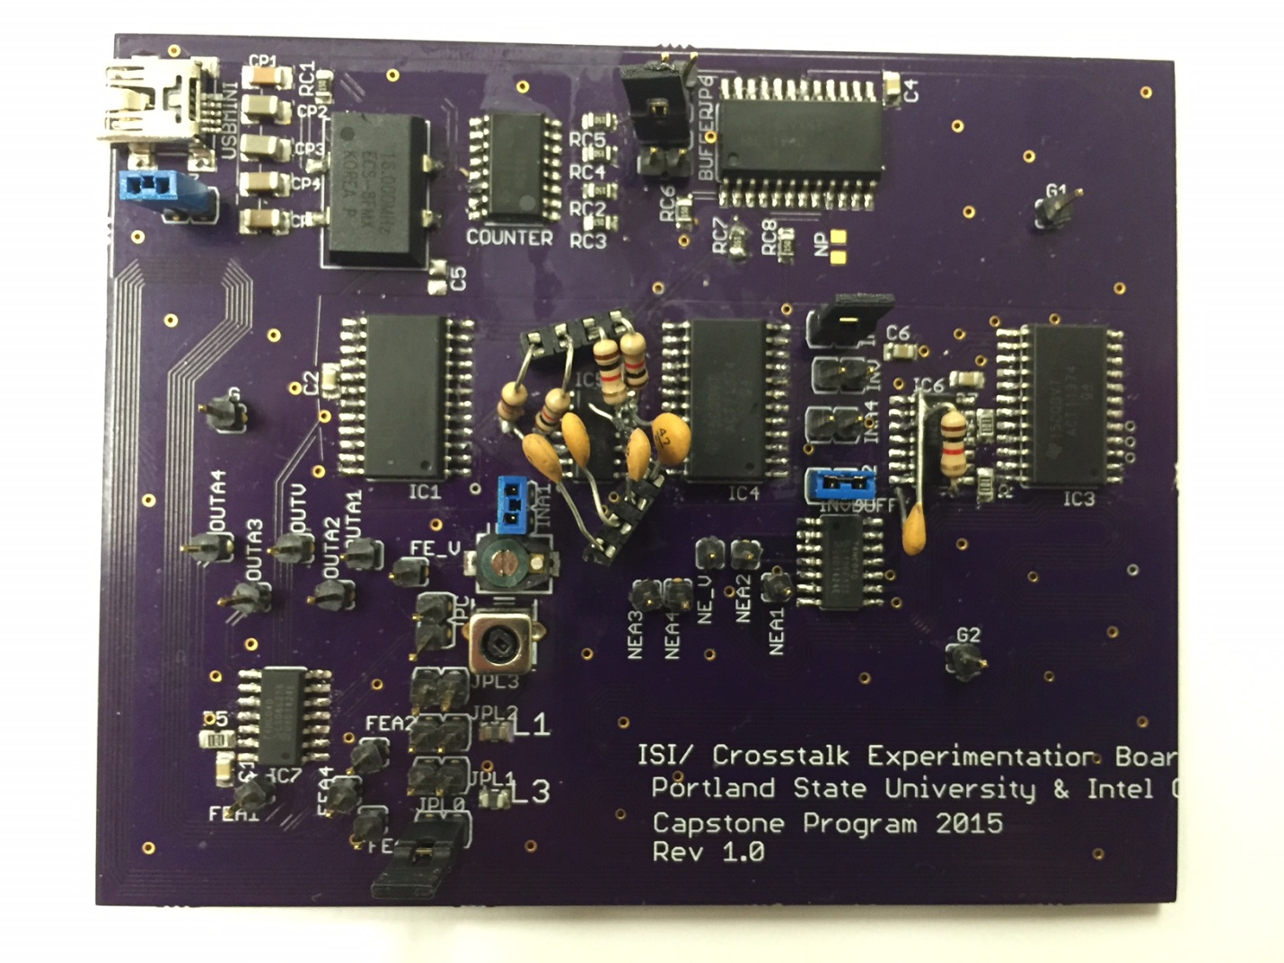
ISI Finished Board

Slide 8
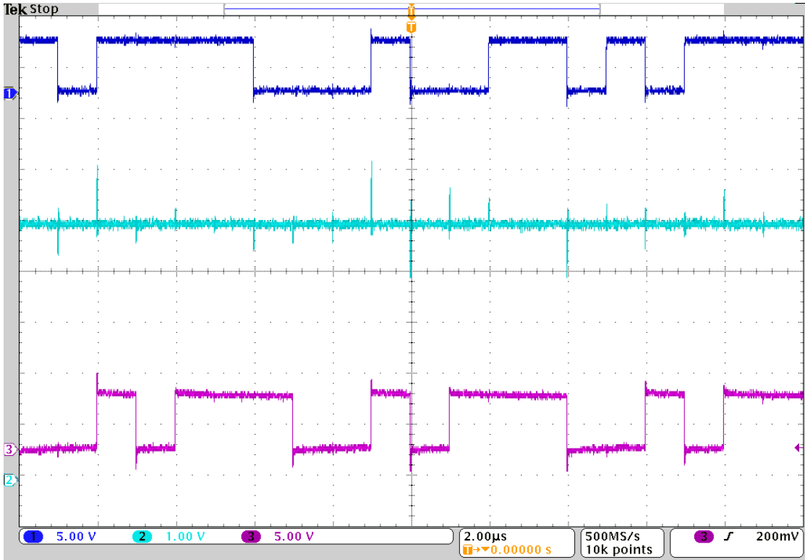
ISI Measurement Results

Slide 9
Testing Approach
Modular Testing
Integrated Testing

Slide 10
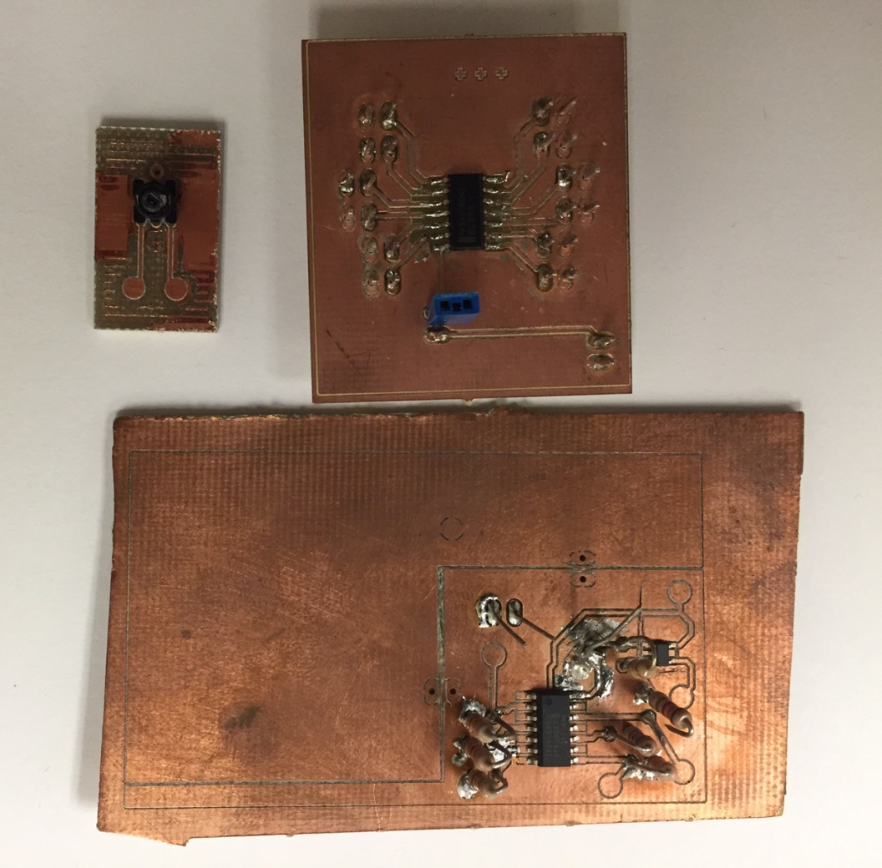
Testing
Modular testing breakout boards
Integrated testing of CLK and loaded inverter

Slide 11
Main Problems
Problems due to time constraints and loss of resources (two team members)
Specific problems with MSGT
Specific problems with ISI

Slide 12
Problem Solutions
Board Modifications
Layout Changes
Scope Changes

Slide 13
Conclusion
Thank you Tony
Thank you to Intel for supporting our project
Thank you to Dr. Morris for meeting each week and helping with the process.

